Slide 1
GROUP BY and HAVING
- Morshedul Arefin

Slide 2
GROUP BY Clause
It is used to group rows with the same values into summary rows.
It is often used with aggregate functions (COUNT(), MAX(), MIN(), SUM(), AVG()) to group the result-set by one or more columns Usage: SELECT column1, SUM(column2), AVG(column3), ... FROM table_name GROUP BY column1;

Slide 3
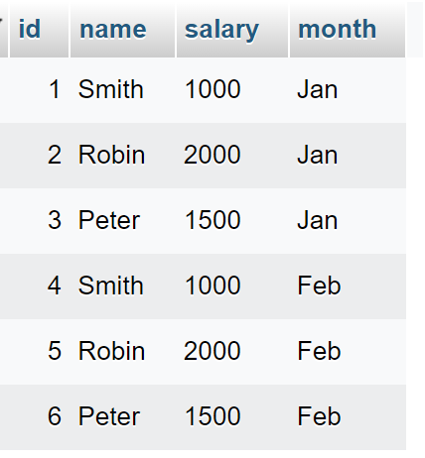
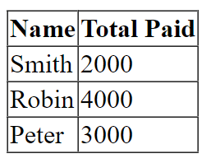
Example
$statement = $conn->prepare("SELECT name, SUM(salary) AS 'Total Paid' FROM employees GROUP BY name");
$statement->execute();
$result = $statement->fetchAll(PDO::FETCH_ASSOC);

Slide 4
HAVING Clause
It is used to filter group results that were aggregated using the "GROUP BY" clause.
It allows you to specify conditions for the groups, rather than for individual rows. Usage: SELECT column1, SUM(column2) FROM table_name GROUP BY column1 HAVING SUM(column2) > 100;

Slide 5
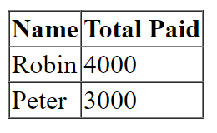
Example
$stateme$statement = $conn->prepare("SELECT name, SUM(salary) AS 'Total Paid' FROM employees GROUP BY name HAVING SUM(salary) > 2500");
$statement->execute();
$result = $statement->fetchAll(PDO::FETCH_ASSOC);

Slide 6
GROUP BY with JOIN
GROUP BY can be used in combination with the "JOIN" clause to aggregate data from multiple tables. Usage: SELECT t1.column1, SUM(t2.column2)
FROM table1 t1
JOIN table2 t2
ON t1.id = t2.id
GROUP BY t1.column1;

Slide 7
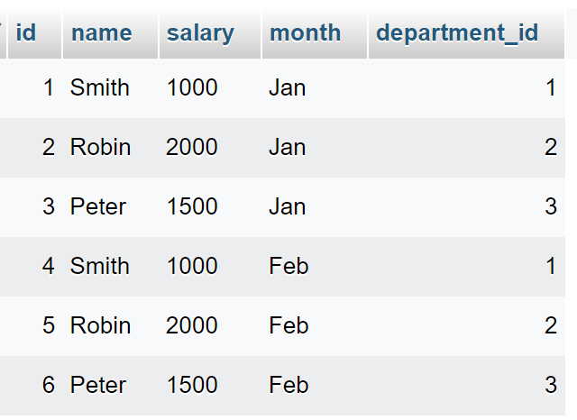
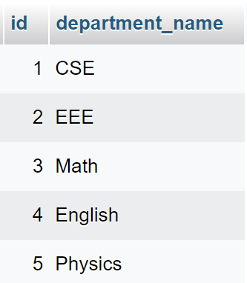
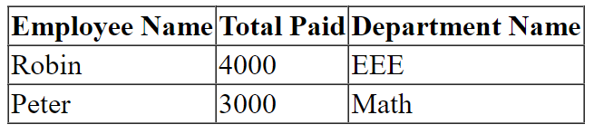
Example
$statement = $conn->prepare("SELECT e.name, SUM(e.salary) AS 'Total Paid',
d.department_name
FROM employees e
INNER JOIN departments d
ON e.department_id = d.id
GROUP BY e.name, d.department_name HAVING SUM(e.salary) > 2500");
$statement->execute();
$result = $statement->fetchAll(PDO::FETCH_ASSOC);

